Slide 1



Overview of the CoWASH IV Program and its Achievments in Central Ethiopia
March, 2025
Wolkite, Ethiopia

Slide 2
Introduction
The Community-led Accelerated WASH (COWASH) project was established to promote the efficient use of CMP (Community Managed Project) financing for rural WASH development. It is conducted under the umbrella of the country’s One WASH national program.
The Program is funded by:
The Governments of Finland
The Governments Ethiopia And
Project Beneficiaries.

Slide 3
Introduction … Cont’d
COWASH is a bilateral project funded by the Government of Ethiopia (GoE) and the Government of Finland (GoF) with four phases to date.
Phase I, July 2011 - Sep. 2014
Phase II, Oct. 2014 - June 2016
Phase III, Aug. 2016 – June 2020
Phase Iv, July 2020 – December 2026
The bilateral cooperation started in 1994 with the Rural Water Supply and Environmental Program (RWSEP) in Amhara Region.
In 2011, it was scaled up to the national level and replicated to four more regions (Benishangul Gumuz, Oromia, SNNPR and Tigray) with the objective to reach people with safe water, and improved sanitation and hygiene services. That same year the project got its name: COWASH.

Slide 4
Intro… cont’d
Currently, it operates in 104 Woredas of 7 Regional States of Ethiopia.

Slide 5
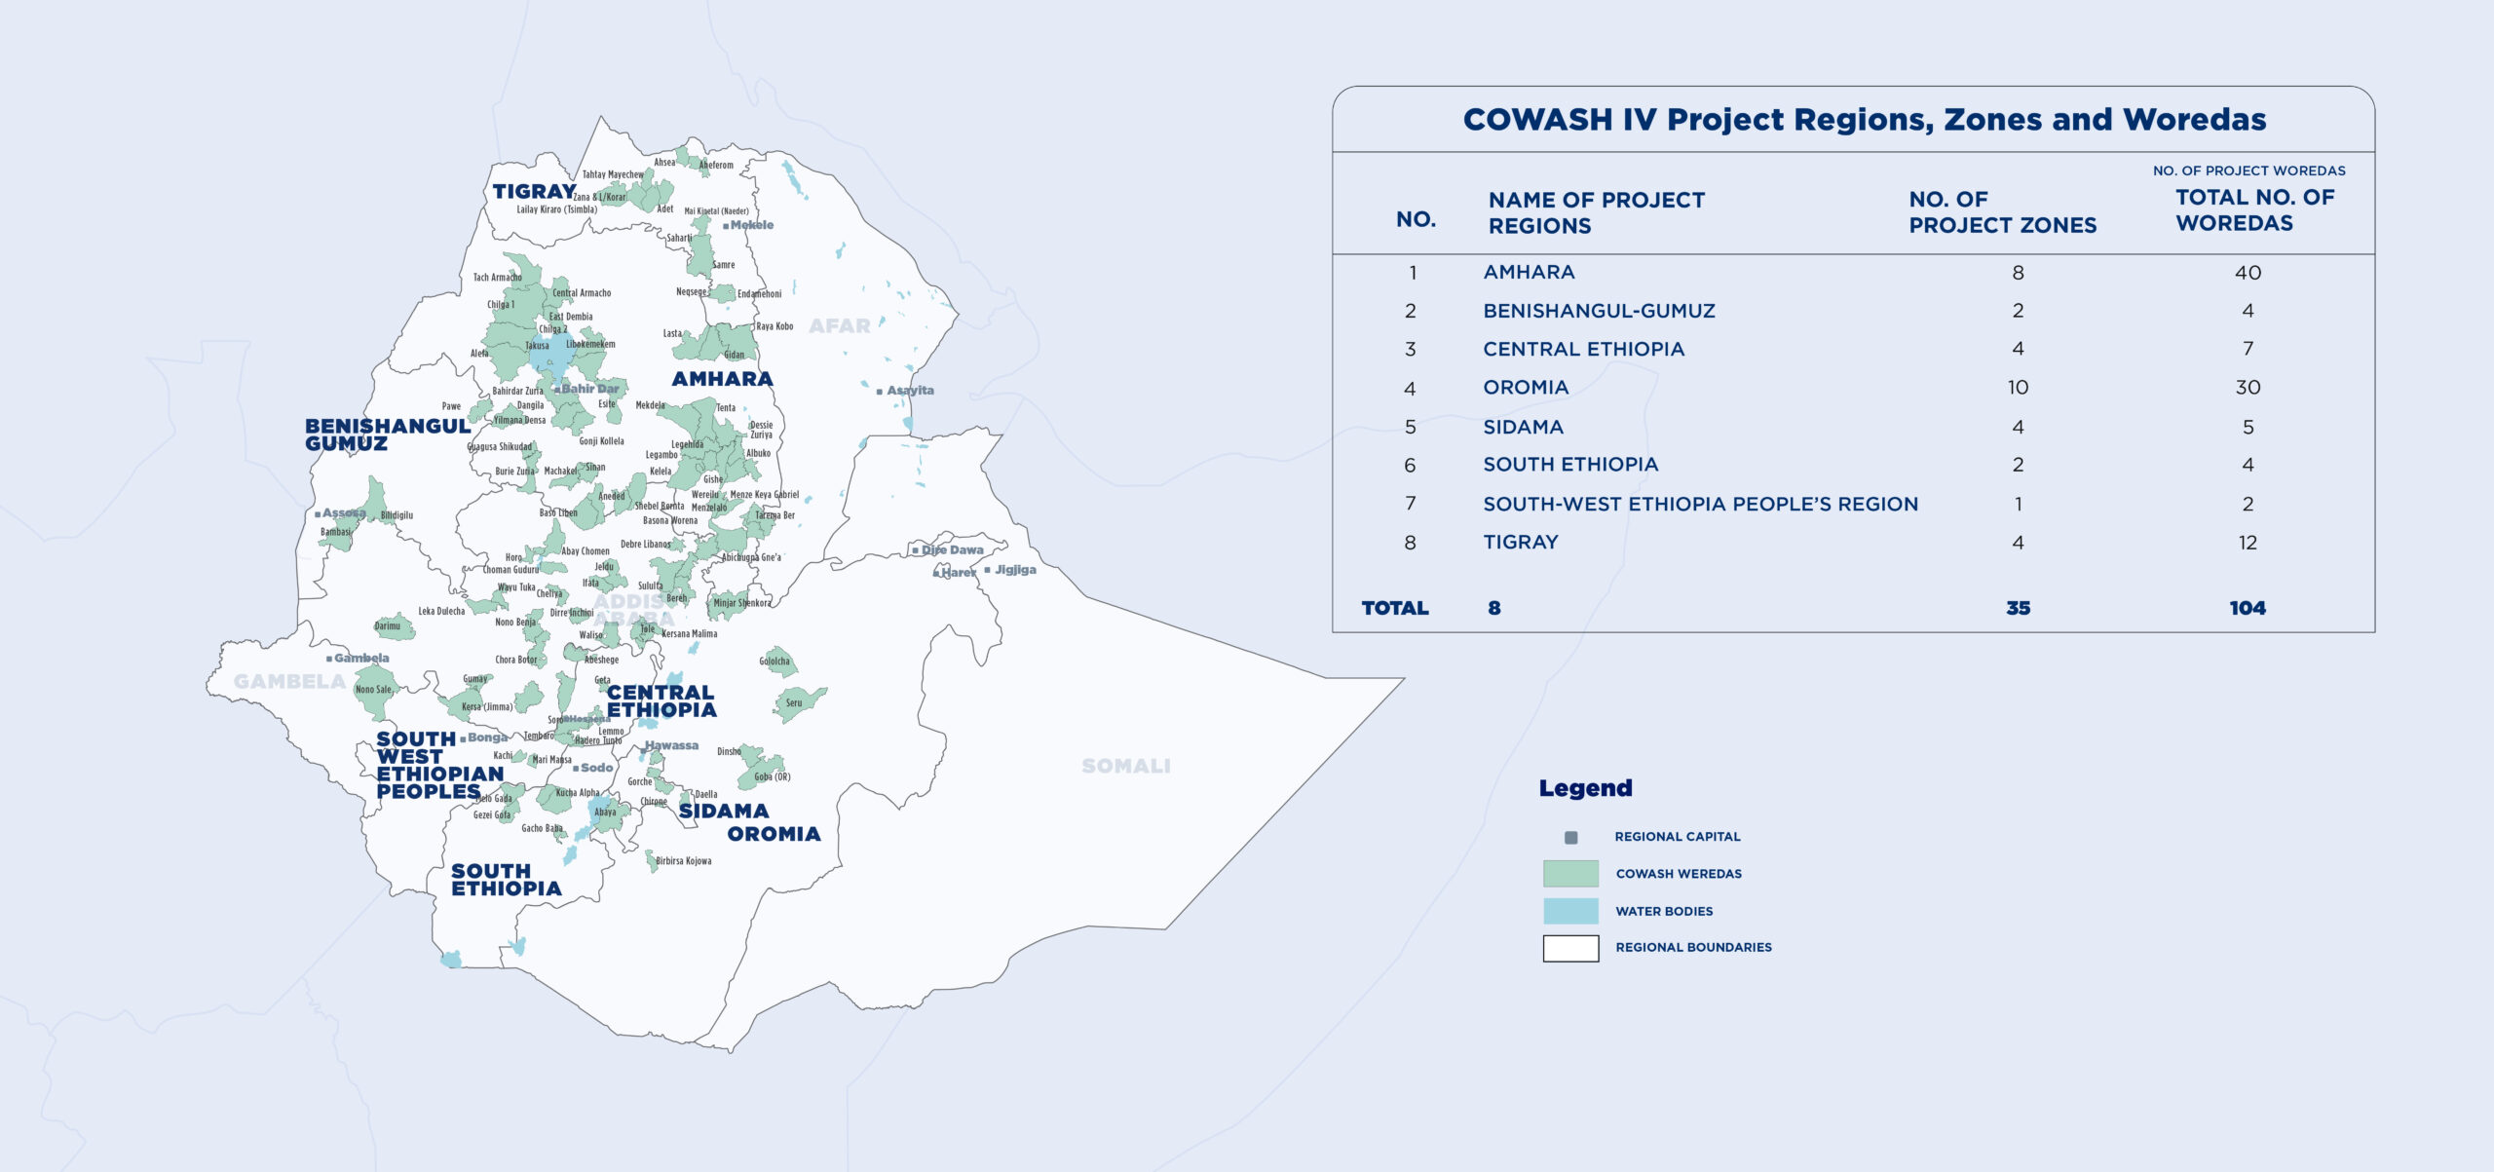
CoWASH IV Project Regions, Zones and Woredas

Slide 6
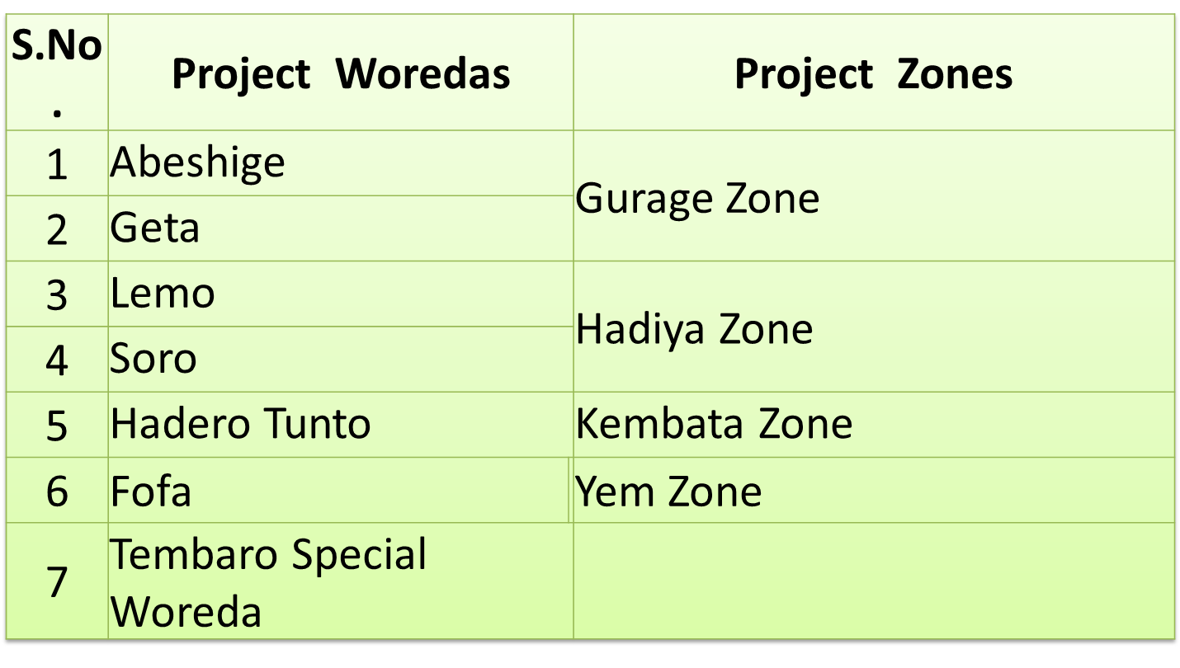
COWASH IV PROJECT WOREDAS IN CENTRAL ETHIOPIA

Slide 7
COWASH IV: Objective and Outcomes
There Are 5 Outcomes in COWASH IV
Outcome 1: Increased & Sustained Access of Safe Climate Resilient Community Water Supply in Rural Areas of Project Woredas
Outcome 2: Increased Access to and Usage of Improved Household Latrines & Increased Practice of Hand washing with Soap in COWASH IV Water Supply Beneficiary Households of Project Woredas

Slide 8
COWASH IV Objective and Outcomes (Continued)
Outcome 3: Improved Institutional WASH by Narrowing the Gap in Improved Institutional Latrine, Climate Resilient Safe Water Supply, and Mensural Hygiene Management (MHM)
Outcome 4: Sustainability and inclusivity of achieved WASH outcomes enhanced
Outcome 5: COWASH IV implementation effectively managed, lessons learnt, documented, communicated and shared and put into action

Slide 9
Implementation Modalities
The Community Managed Project (CMP) approach is one of the four service delivery models for the development and use of rural WASH infrastructure in Ethiopia.
1. Woreda Managed Projects (WMP)
2. Community Managed Projects (CMP)
3. NGO Managed Projects and
4. Self Supply.

Slide 10
Community Managed Project Approach (CMP)
Implementation strategy of COWASH is based on Community Managed Project (CMP) Approach and it has the following unique features:
Sustainability of schemes is higher because of high levels of ownership and communities involvement at all levels
Transfers funds and project management responsibilities including purchasing of materials & contracting the services to communities, represented by Water, Sanitation and Hygiene Committee (WASHCO)
Simplified implementation arrangement: clear policy and guidelines are in place with intensive capacity building components.

Slide 11
Benefits of the CMP Approach
Accelerated implementation rate of projects/increased the number of project to be constructed yearly.
Increased functionality of schemes (due to increased users’ ownership, construction quality and O&M capacity)
Minimized wastage of construction materials as materials are procured only when needed (cost efficient)
Easy to get a project information (each project has a file)
Increased job opportunities at local level (woreda level suppliers, artisans are involved)
Increased household latrine coverage (criterion to get CMP grant)
Community empowerment - increased women leadership

Slide 12
Major Achievements of COWASH IV
Safe Climate Resilient Community Water Supply
So far, 131 (125 new & 6 rehabilitation) community improved water supply schemes have been completed in the rural parts of the seven project Woredas and brought the following achievements.

Slide 13
Major Achievements ... Cont’d
Results Indicator | Baseline, end of 2013 EFY | 2015 EFY Achievement (Cumulative) | 2016 EFY Plan | 2016 EFY Achievement (Cumulative)
R 1.1: Average Rural Community Water Supply Access Coverage of Project Woredas BY ALL WASH ACTORS | 26.8 | 38.6 | 42.3 | 42.3
R 1.2: % of Rural People using safe Water Services constructed/rehabilitated by COWASH IV - Average |  | 3.9 | 5.7 | 6.2
Safely Managed |  | 0.2 |  | 0.2
Basic |  | 2.8 |  | 4.2
Limited |  | 1.0 |  | 1.8

Slide 14
No. of New Community Water Supply Schemes Constructed by COWASH IV by Technology

Slide 15
No. of Community Water Supply Schemes Rehabilitated with the support of COWASH IV
Type of Water Point(WP) | Cumulative Community WPs Rehabilitated in COWASH IV
OSPD | 1
RPS from SP | 5
Total | 6

Slide 16
Beneficiery Population of Community WPs (New/ Rehabilitated)
Woreda | No. of Beneficieries
Lemo | 7,434
Soro | 12,211
Abeshige | 7,288
Geta | 7,490
Hadero Tunto | 13,358
Tembaro Special Woreda | 10,352
Fofa | 7,308
Total | 66,169

Slide 17
Beneficieries....

Slide 18
COWASH IV Beneficiary Households (HHs) having access to Improved Latrines
Cumulative No. of COWASH IV Community WPs Beneficiary HHs as per the SDG Sanitation Service Levels
Safely Managed | Basic | Limited | Unimproved | Open Defecation (OD) | Total
165 | 3,965 | 1,770 | 9,286 | 1996 | 17,182

Slide 19
Hand Washing Practices with Soap & Water
The project is giving emphasis to improving hand hygiene practices in the rural areas of the project woredas.
Every community water supply beneficiary household is expected to install designated hand washing facilities at their premises and practice good hand hygiene behavior.

Slide 20
Hand washing Practices….
Cumulative No. of COWASH IV WP Beneficiary HHs as per the SDG Hygiene Service Levels
Basic | Limited | No Facility | Total
5,066 | 7,910 | 4,206 | 17,182

Slide 21
Credit services for Household Sanitation and Hygiene Products
In some project woredas such as Fofa, Lemo, Tembaro Special Woreda, Soro and Geta woreda of the region, the establishment of WASH-SLAs has started contributing to the improvement of the sanitation situation of the rural households.
Hence, 14 WASH-SLAs with a total membership of 244 rural households and a saving of Birr 207,033 have been established.

Slide 22
Improved institutional WASH Safe water supply
COWASH IV gives emphasis to improving the water supply situation of institutions: schools and health facilities.
Until the end of the reporting period, 34 rural schools have got access to improved water supply (27 from Expansions and 7 from RPS from spring sources) with the support of COWASH IV.
These COWASH IV-supported facilities have benefited over 25,426 students, teachers and administrative staff of the institutions of which 48.91% of the total beneficiaries) are females.

Slide 23
Beneficiaries of School Water Supply Schemes

Slide 24
Improved institutional WASH….
Furthermore, two MHM blocks have been completed in the project woredas together with school improved latrines.

Slide 25
Beneficiaries of School Water Supply
 | Cumulative No. of People Benefitted from COWASH IV Constructed/Rehabilitated School WPs (in Schools having Improved Latrines)
 | Female with No Disability | Female with Disability | Male with No Disability | Male with Disability | Total
No. of Beneficiaries | 12,160 | 276 | 11,922 | 1,068 | 25,426

Slide 26
Beneficiaries of School Latrines
One of the main focus areas of COWASH IV is the construction of improved latrines for institutions (schools and health facilities) and rural households.
Since the launching of COWASH IV in the project woredas, 38 schools of the project woredas have got access to school-improved latrines constructed as per the standard (female and male students each 1 block with four seats and 1 block for teachers).

Slide 27
Beneficiaries of Schools Constructed Improved Latrines
Cumulative No. of People Benefitted from COWASH IV School Latrines (in Schools having access to Improved Water Supply)
Female with No Disability | Female with Disability | Male with No Disability | Male with Disability | Total
8294 | 94 | 9521 | 106 | 18,015

Slide 28
Health Institution WASH
Improving the water supply situation of the health institutions, having already improved latrine access, is one of the focus areas of COWASH IV.
Hence, since the launching of COWASH IV, rural health institutions /health centers and health posts/ have got 32 improved water and 25 latrines as per the standards.

Slide 29
Human Capacity of COWASH IV Stakeholder
Human capacity building activities are the major component of COWASH IV project as it believes building knowledge and improving the implementation capacity of stakeholders at all levels will improves the quality of services and performance thereby ensure the sustainability of facilities.
Since the launching of COWASH IV, a total of 7,274 people have been trained on various issues related to the CMP approach of whom 2,989 are females.

Slide 30
Human Capacity of COWASH IV Stakeholder
Level | Cumulative No. of People Trained by Sex and Disability
 | Female With Disability | Female With No Disability | Male With Disability | Male With No Disability | Total
Regional Level | 0 | 44 | 2 | 319 | 365
Zone Level | - | - | - | - | -
Woreda Level | 113 | 2832 | 126 | 3838 | 6,909
Total | 113 | 2,876 | 128 | 4,157 | 7,274

Slide 31
Physical Capacity of COWASH IV Stakeholders
List of Materials/Equipment | Unit | Quantity Procured | Is the Procured Fixed Asset registered in government assets registry form (Yes/No)
 |  | Cumulative
Motorbike | No. | 22 | yes
Printer | No. | 9 | yes
Laptop | No. | 12 | yes
LCD Projector | No. | 1 | yes
Photocopy machine | No. | - | ongoing
Scanner | No | - | ongoing
Filing cabinet | No | 5 | yes
Binding machine | No | - | ongoing
Procure external hard drive (for RSU in BoW) | No | 7 | yes
procure Wi-Fi Routers for RSU | No. | 7 | yes

Slide 32
Major Areas of Focus
Performance Monitoring Indicators In CoWASH

Slide 33
Women empowerment
In Ethiopia, women and girls are often the primary collectors, transporters, and water users for household consumption.
Women are primarily responsible for health and childcare and are guardians of household hygiene.
Availing safe water at close distances to households assists women and girls by reducing travel and queue times and improving the health conditions of the user communities.

Slide 34
Women empowerment…
Girls can enhance their school attendance and performance; women can use their free time to accomplish productive work and engage in social activities.
Access to water and sanitation facilities helps reduce the vulnerability of women and girls to sexual harassment and assault while travelling long distances to collect water for family use, as well as when they have to go out of the home to urinate or defecate.

Slide 35
Performance Monitoring Indicators In CoWASH
Monitoring Indicators
% of COWASH Phase IV WASHCOs having at least 50% women members
1
% of WASHCO leadership positions filled with women in COWASH Phase IV (Note: Leadership/ management positions are: chair, secretary and treasurer)
2
% of COWASH Phase IV WASHCOs having women in all three main management positions
3

Slide 36
Performance Monitoring Indicators …
% of women-led WASH enterprises having at least 40% of women members
04
% of leadership positions filled with women in WASH enterprises established by COWASH support
05
% of women who participated in capacity building trainings
06

Slide 37
17 COWASH Entry Points in Women Empowerment Strategies Employed
Assign Full time gender specialist and/or a gender focal point in the regional support unit office of COWASH.
Prepare and disseminate training guidelines.
Use gender disaggregated data for monitoring, evaluation and reporting.
Award grass root level gender champions / best performing WASHCOs to inspire other WASHCOs

Slide 38
Call To Action
We recommend all WASH sector stakeholders at different tiers to join hands to promote women empowerment in WASH to transform the lives of rural women and girls. Potential areas to take up by WASH sector stakeholders include but not limited to:
Leveraging human, financial, and material resources to advocate and implement women and girls empowerment.
Contextualize issues to come up with evidence based women empowerment interventions.
Sharing knowledge and experiences using various methods and channels to address women and girls empowerment issues.
Scaling up of innovative strategies and best practices to empower women and girls.
Creating a space for the rural women and girls to voice pertinent issues that will enable them to solve the challenges they face.
COWASH endorses and call upon all WASH sectors to flag the motto of:
“Empowering women is empowering the community”.

Slide 39
Thank you for the Undivided Attention!

